Slide 1
Mapping Riparian corridors on the central coast
Riparian Summit
October, 2017
Davis, CA
Ross Clark
rclark@mlml.calstate.edu

Slide 2
GOALS of Project
determine the best and most efficient way of identifying and digitizing the riparian corridor
identify riparian boundaries based on an analysis of different sources of remote sensing data, principally aerial imagery

Slide 3
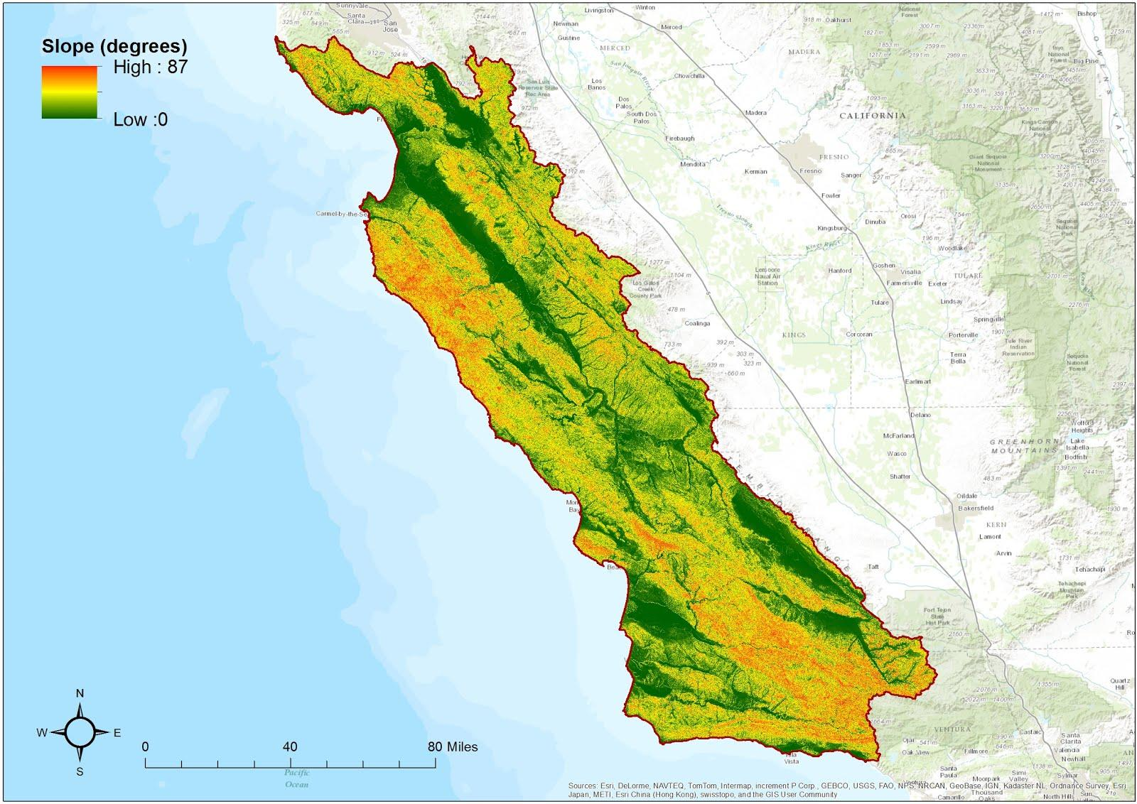
RipZET Slope module

Slide 4
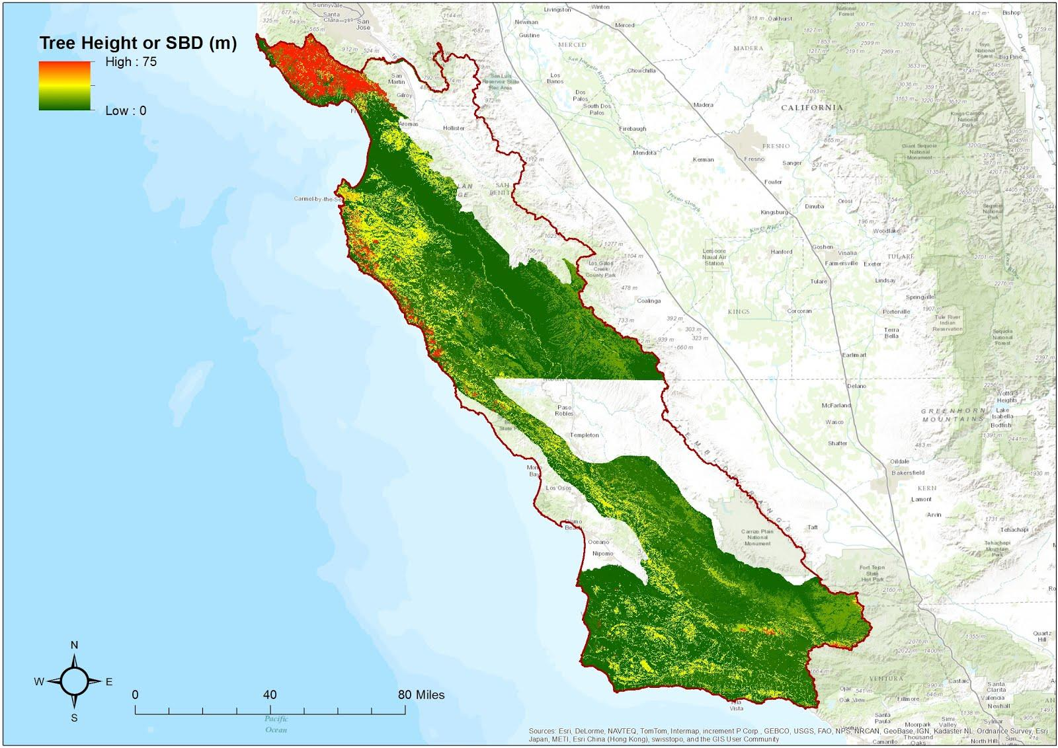
RipZET Vegetation module (calveg)

Slide 5
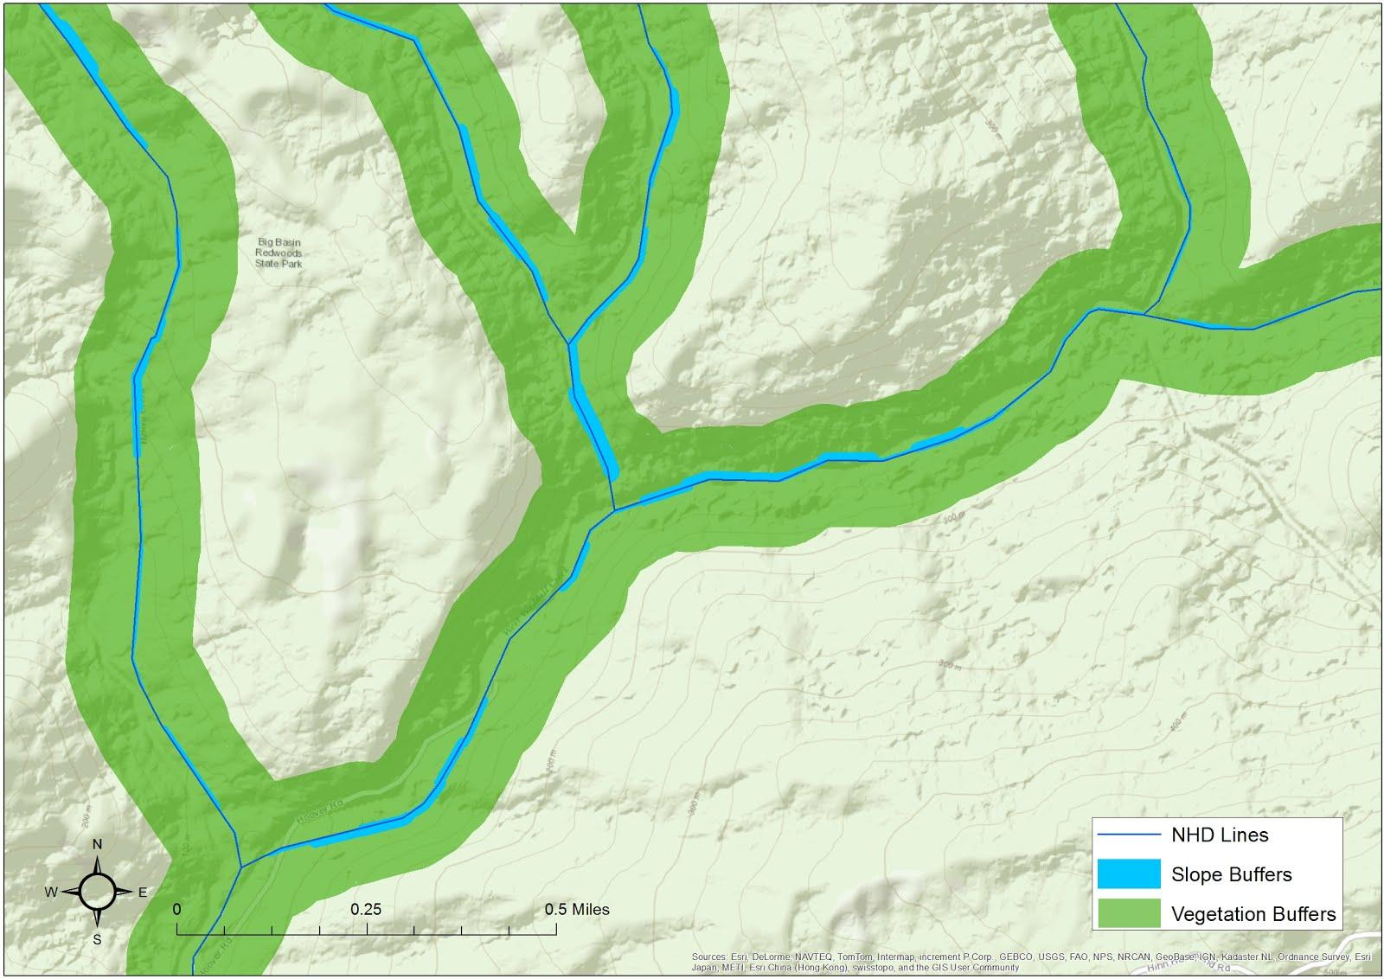
Combined Output (big basin)

Slide 6
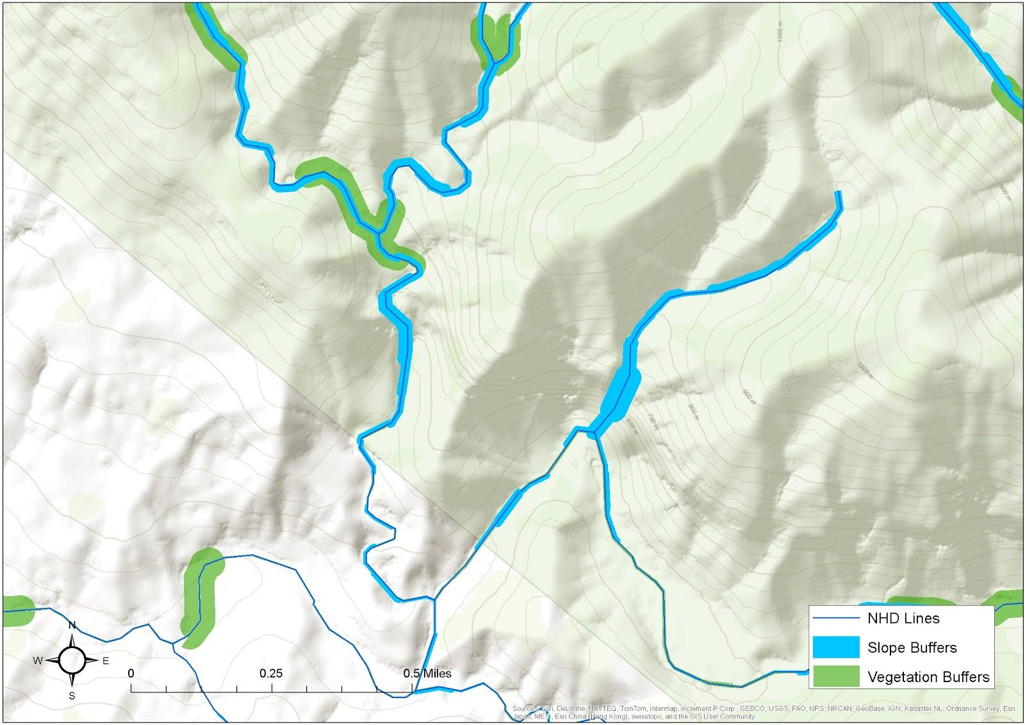
Combined output (santa Barbara)

Slide 7
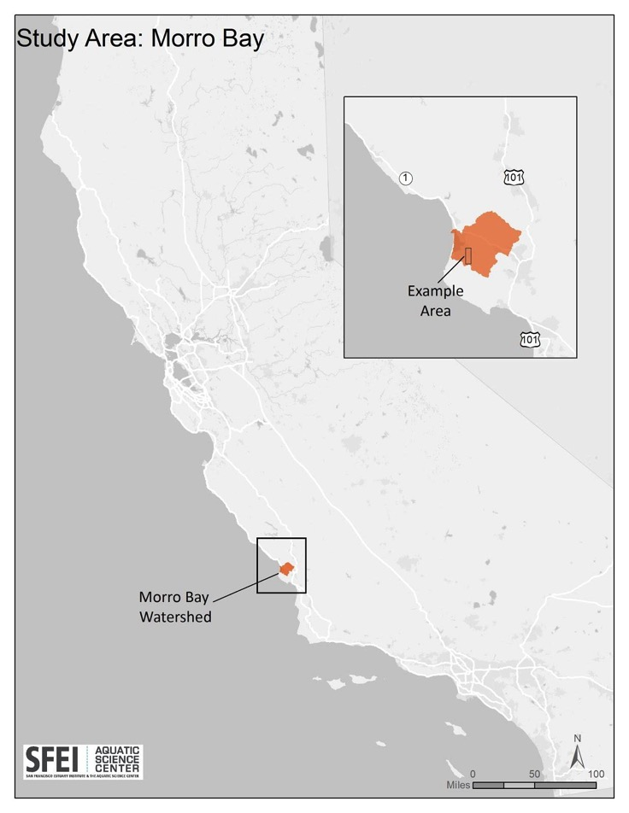
Remote Riparian Assessment

Slide 8
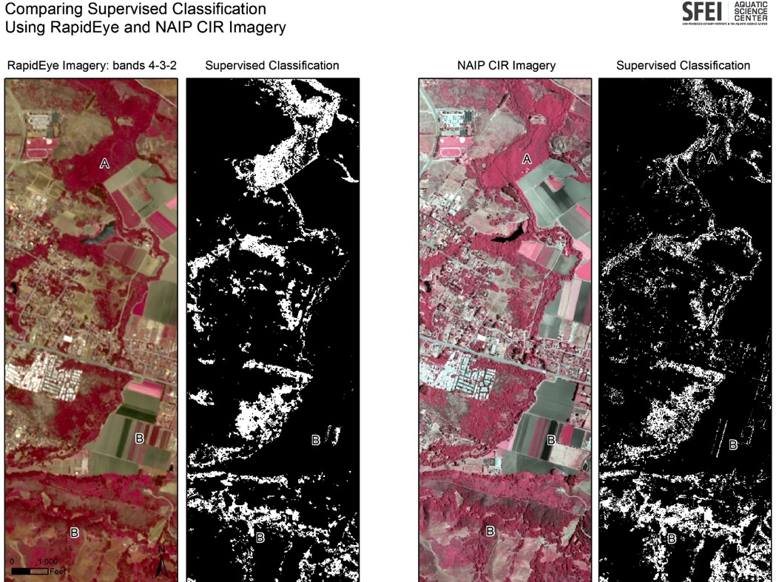
GIS-based tree mapping

Slide 9
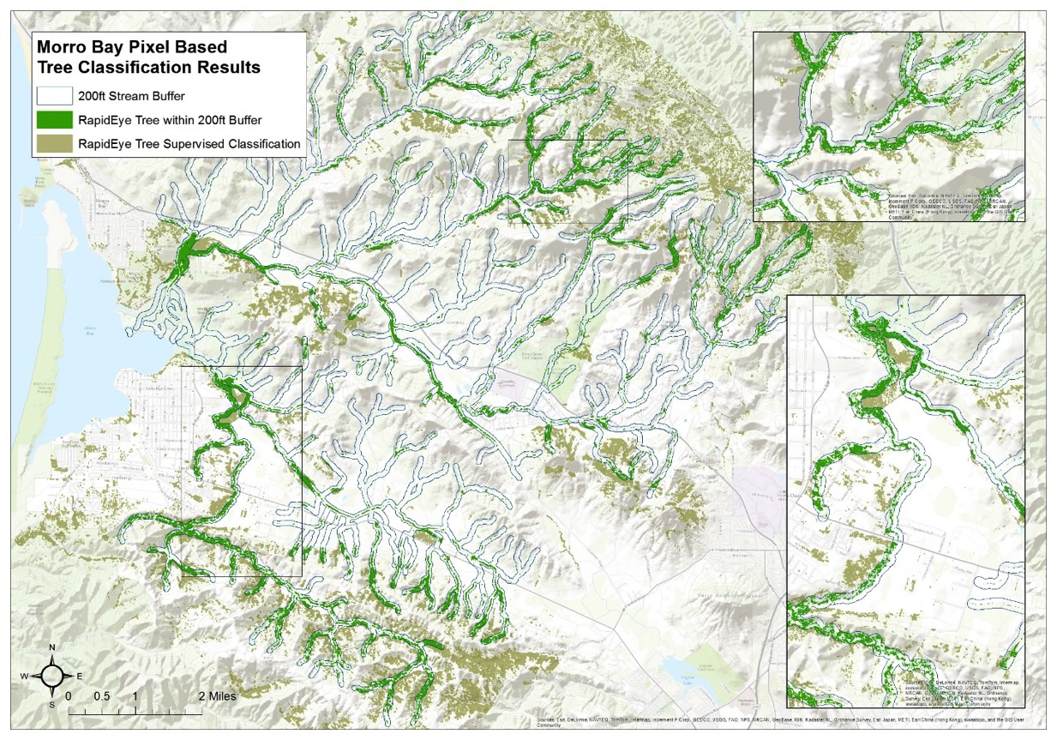
Morro bay tree cover

Slide 10
Percent Tree cover at different buffer distances
Buffer distance based on:
30m
70m
10x Strahler stream order
RipZET Veg and Slope output

Slide 11
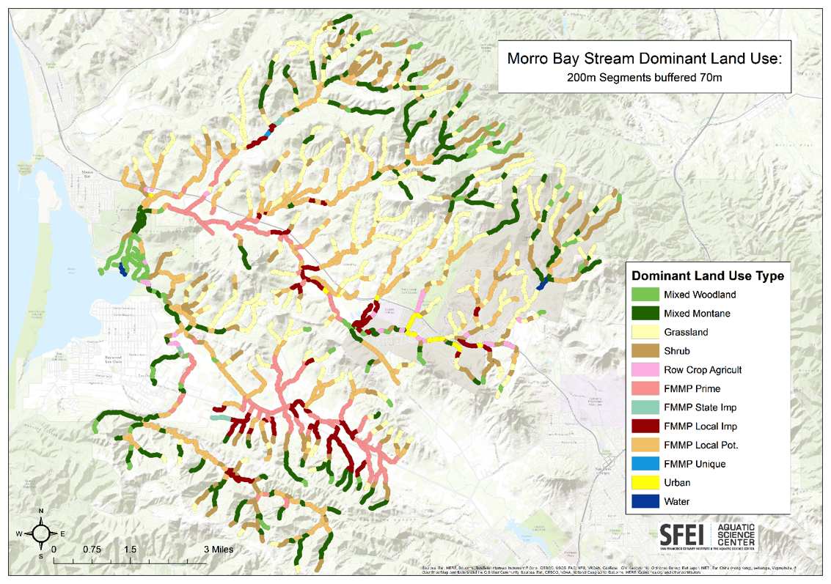
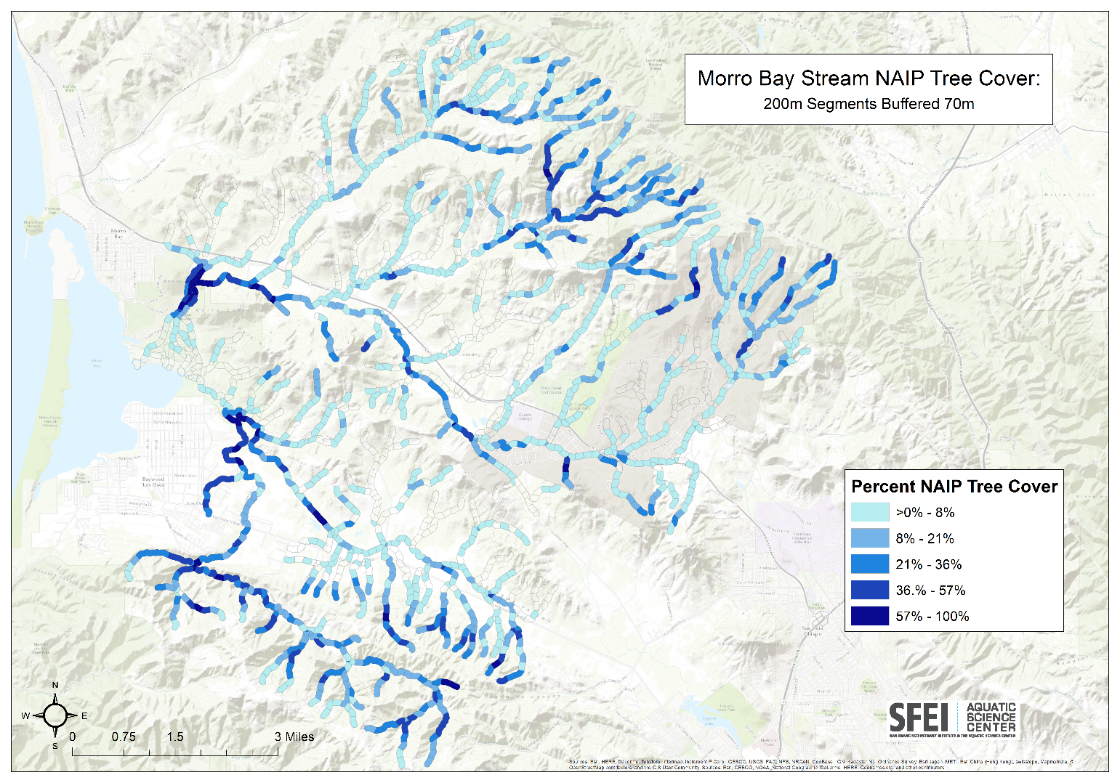
Land use stress and Tree cover

Slide 12
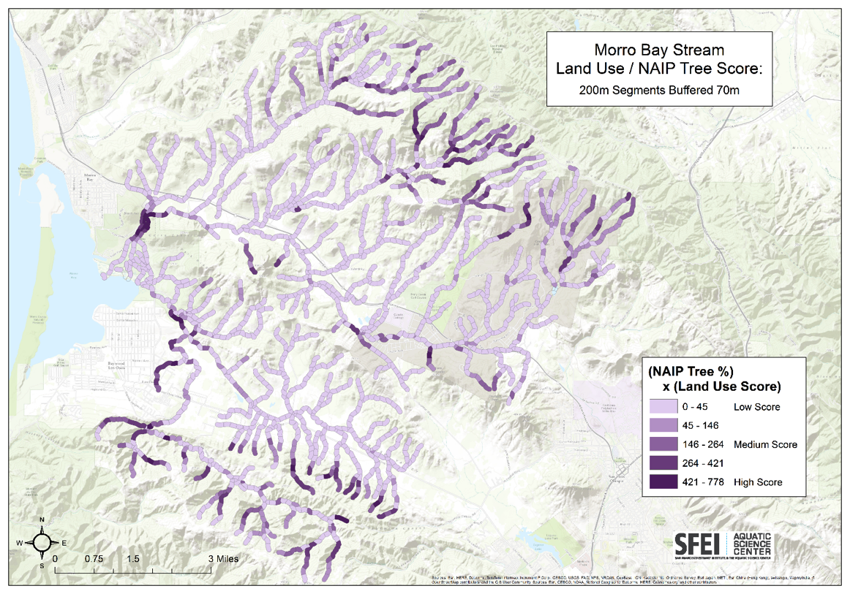
Remote assessment

Slide 13
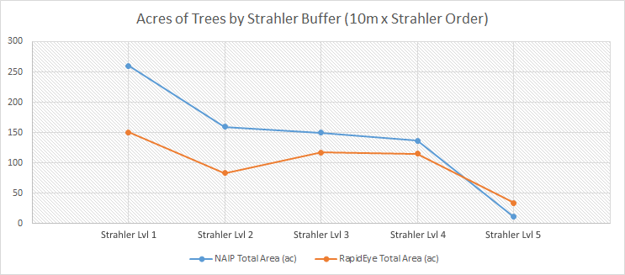
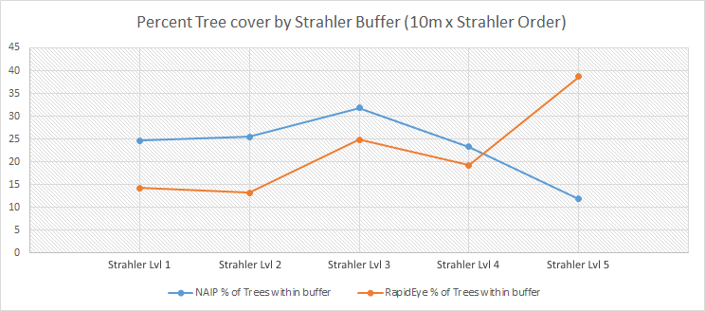
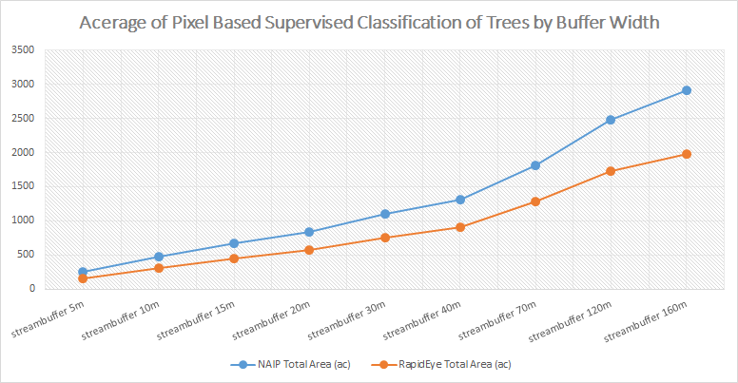
riparian extent in morro bay

Slide 14
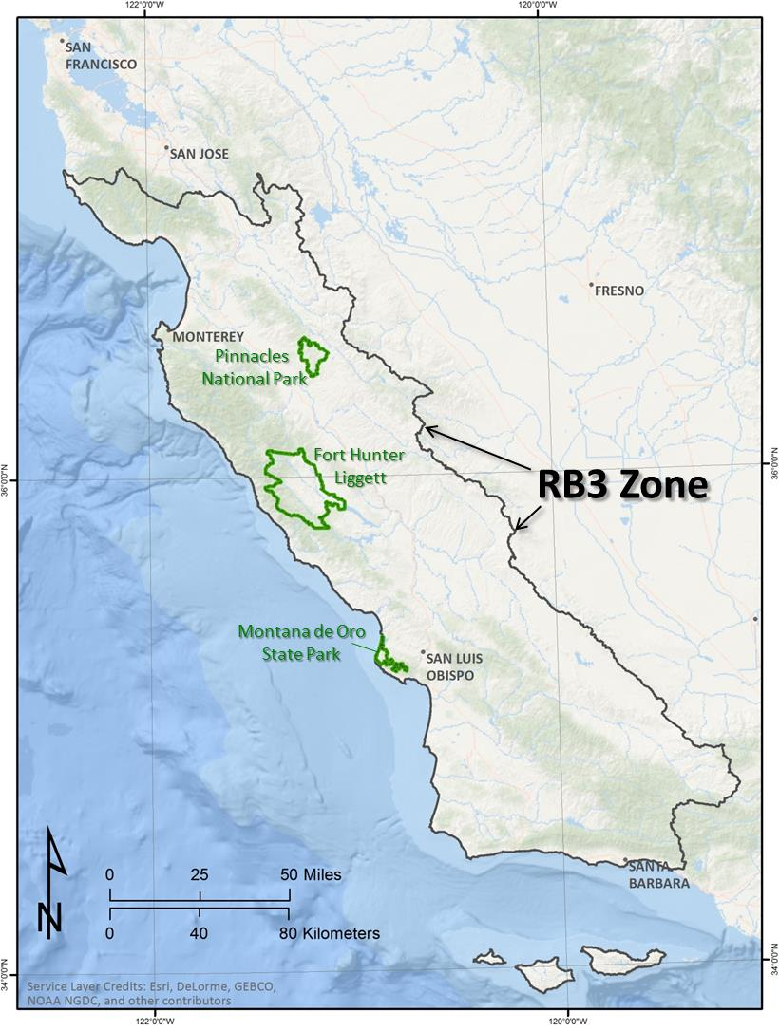
Map of Riparian Resources

Slide 15
Methods
Stream network is derived from a digital elevation model (DEM) and assigned a Strahler order number.

Slide 16
Methods
1
2
3
Streams are randomly selected; active riparian zone is identified from NAIP infrared imagery; lines perpendicular to the stream centerline are created to produce width measurements
NDVI (Normalized Difference Vegetation Index) values are created from the NAIP infrared imagery and reclassified to match vegetation types. Buffered lines perpendicular to the stream centerlines (not shown) are used to extract vegetation data for each selected stream.
Slope percent is derived from a DEM and is extracted using buffered perpendicular lines.

Slide 17
Results

Slide 18
Results

Slide 19
Results

Slide 20
Results
Results of the analysis indicate significant differences in riparian width, slope, and tree cover based on stream order.
Additionally, we observed variability in tree cover vs. stream order in different areas of the RB3 zone, suggesting regional patterns based on different ecological zones.

